Slide 1
Title
Week 1 – Visual Studio & Github
Dr Fatmaelzahraa Eltaher
Date, Module name, Lesson number
Web Development 1

Slide 2
Learning outcomes for this lesson
How to use Visual Studio Code for website development
How to use Github Pages to make the website available online

Slide 3
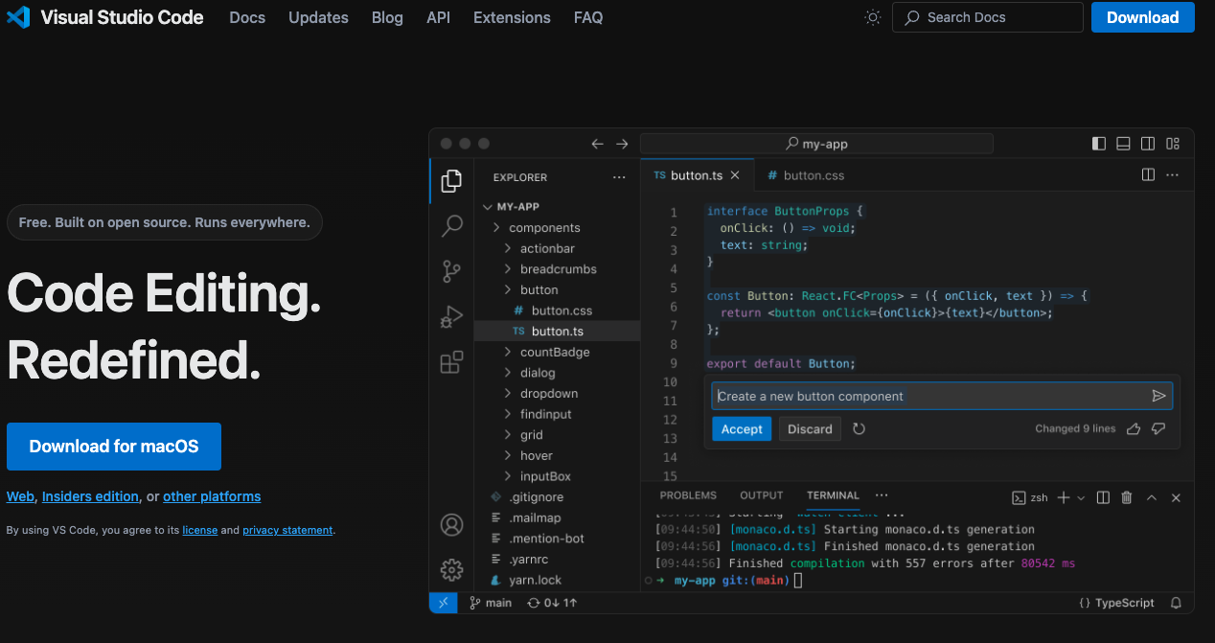
Visual Studio Code
Visual Studio Code is a lightweight but powerful source code editor which runs on your desktop and is available for Windows, macOS and Linux.

Slide 4

GitHub
GitHub is a developer platform that allows developers to create, store, manage and share their code.

Slide 5
GitHub - Glossary
Repository (Repo): a project folder; it contains the files and their history (changes made over time). Multiple users can collaborate with the repository and it can be either public or private.
Commit: A snapshot of the repository at a specific point in time, recording the state of the project.
Branch: a parallel version of the repository. Each repository has one branch named ‘main’, but alternative ones can be created to work on features or bugs.
Merge: Process of integrating changes from one branch to another.
Pull Request (PR): A way to propose changes to a repository. Once reviewed, PRs can be merged into the main branch.

Slide 6
Github - Glossary
Fork: A copy of a repository that you manage. Forking a repository allows you to freely experiment with changes without affecting the original project. You can later submit a PR to the original repository to merge your changes.
Clone: Creating a local copy of a repository on your machine. This allows you to work on the project offline or in your local environment.
Push: Sending your commits from your local repository to a remote repository like GitHub. It involves uploading your local repository changes to a remote repository.
Pull: Updating your local repository with changes from a remote repository. This command fetches and integrates changes from the remote repository into your local repository.

Slide 7
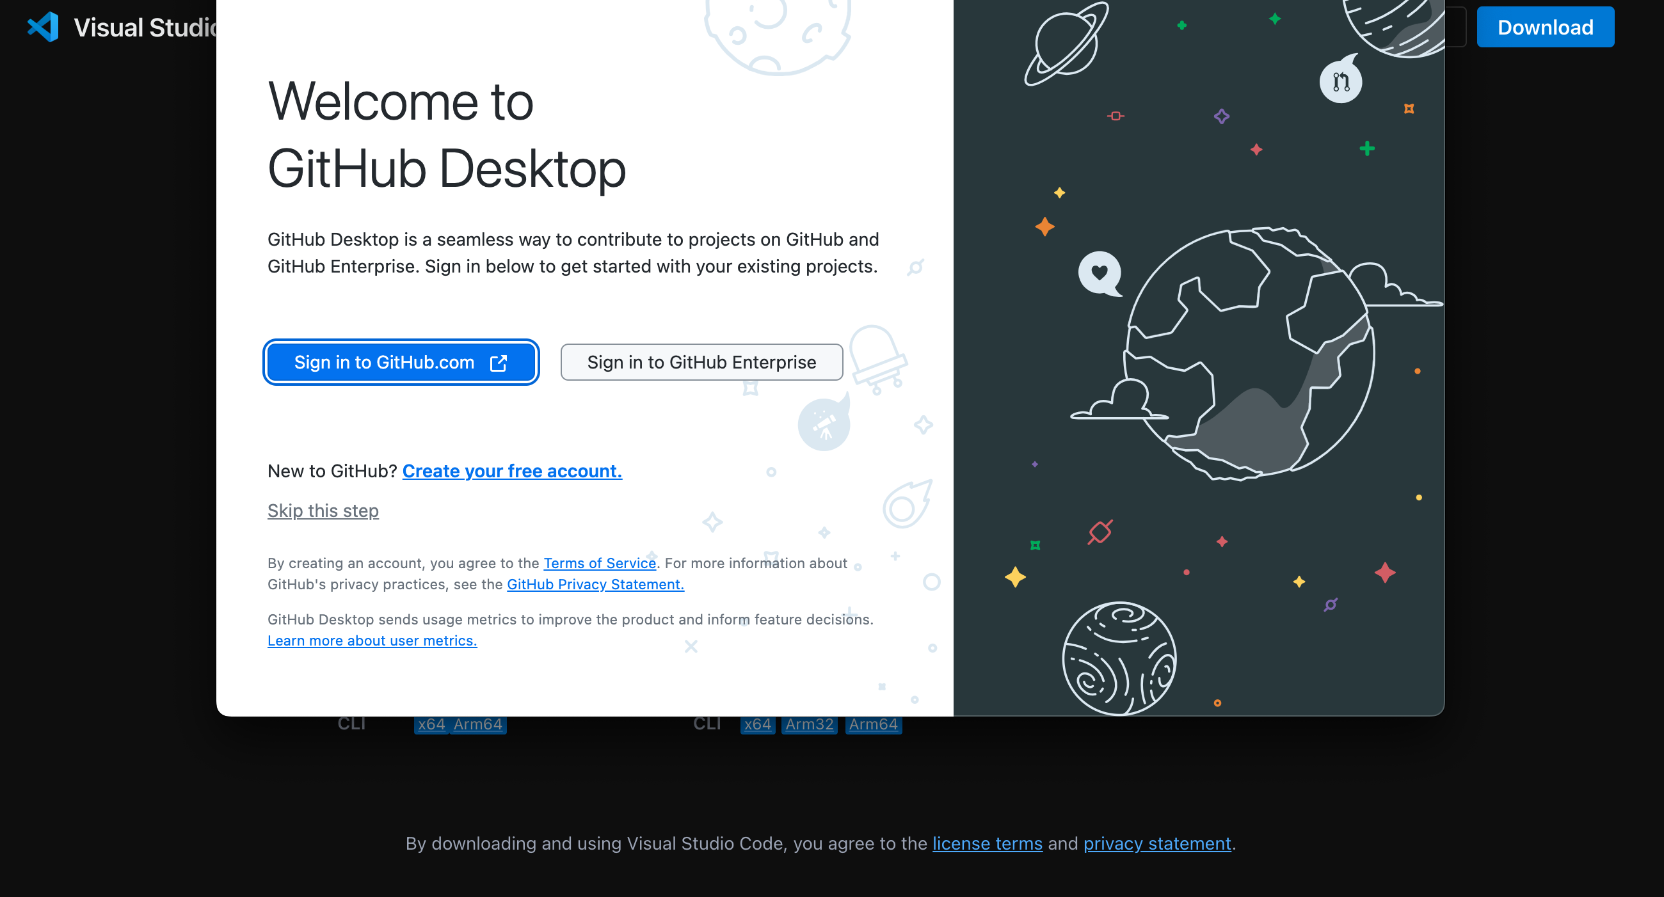
Github - Desktop
It is possible to download GitHub Desktop and update your files from your laptop. This makes the process much easier.

Slide 8
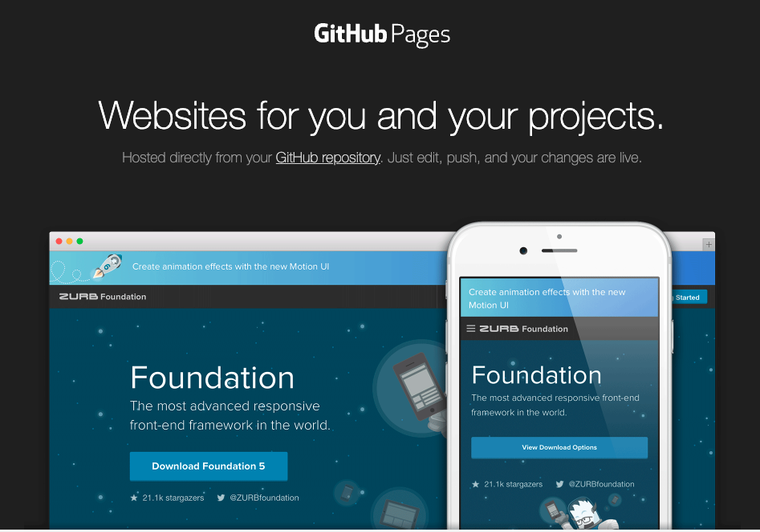
GitHub Pages
GitHub Pages allows you to make your website available to everyone by sharing your code on GitHub.

Slide 9
Links
https://code.visualstudio.com/download
https://desktop.github.com/download/

